Slide 1
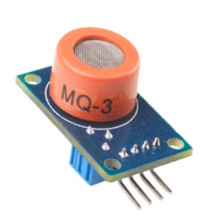

SRI BALAJI CHOCKALINGAM ENGINEERING COLLEGE - ARNI
DEPARTMENT OF ELECTRONICS AND COMMUNICATION ENGINEERING
PROJECT
PANDEMIC-PREVENTING SYSTEM BASED ON
MQ-3 SENSOR
GUIDED BY,
PRABAGARAN D, M.E
PROJECT BY,
HARIKARAN P
VIJAY M , DECE
SRIDHAR M
KIRUBHANITHI A , DECE

Slide 2
CONTENT
Viral pandemic.
Preventing methods.
Importance of hand sanitizer.
The carelessness of people.
MQ3 sensor.
Why MQ3 sensor.
Detection of hand sanitizer.
Conclusion.

Slide 3
VIRAL PANDEMIC
A pandemic is the worldwide spread of a new disease.
Viral respiratory diseases, such as those caused by a new influenza virus or the coronavirus COVID-19, are the most likely to turn into a pandemic.

Slide 4
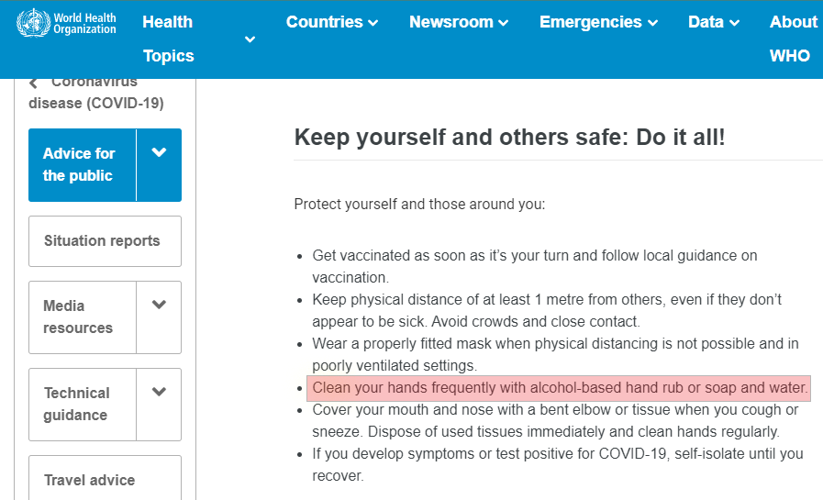
PREVENTING METHODS

Slide 5
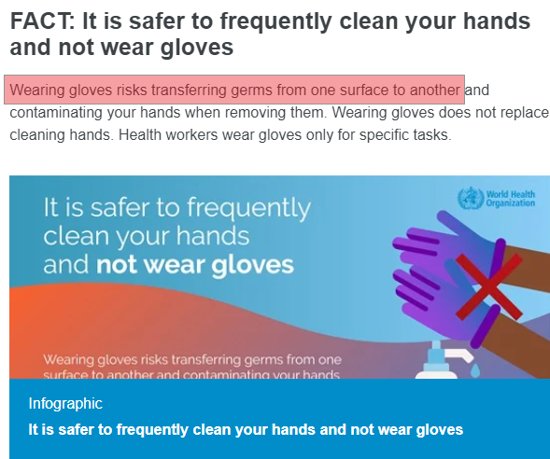
IMPORTANCE OF HAND
SANITIZER

Slide 6

THE CARELESSNESS OF
PEOPLE
Some time people forgot to sanitize their hands.
Some people avoid hand sanitizer by their carelessness.
It helps in transmission of virus from one person to another person.

Slide 7
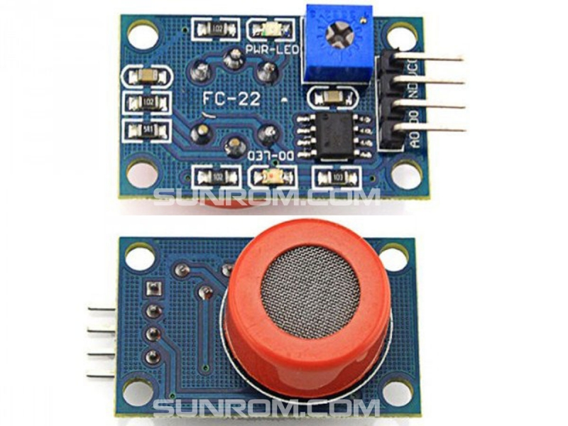
MQ3 SENSOR
It is a low cost semiconductor sensor which
can detect the presence of alcohol gases at concentrations from 0.05 mg/L to 10 mg/L.
The sensitive material used for this sensor is SnO2, whose conductivity is lower in clean air.
It’s conductivity increases as the concentration of alcohol gases increases.

Slide 8
WHY MQ3 SENSOR
The MQ3 sensor is capable to detect ethanol that in gas form.
MQ3 alcohol sensor module can be easily interfaced with Microcontrollers, Arduino Boards, Raspberry Pi etc.
This module provides both digital and analog outputs.
Hand sanitizers contain 60% to 80% of ethanol in it.
In this Project we use MQ3 sensor to detect the hand sanitizer.
By detecting hand sanitizer, we can build lots of protection methods by using electronics.
In this project we can build sanitizer based attendance making system by using MQ3 sensor and RFID reader.

Slide 9
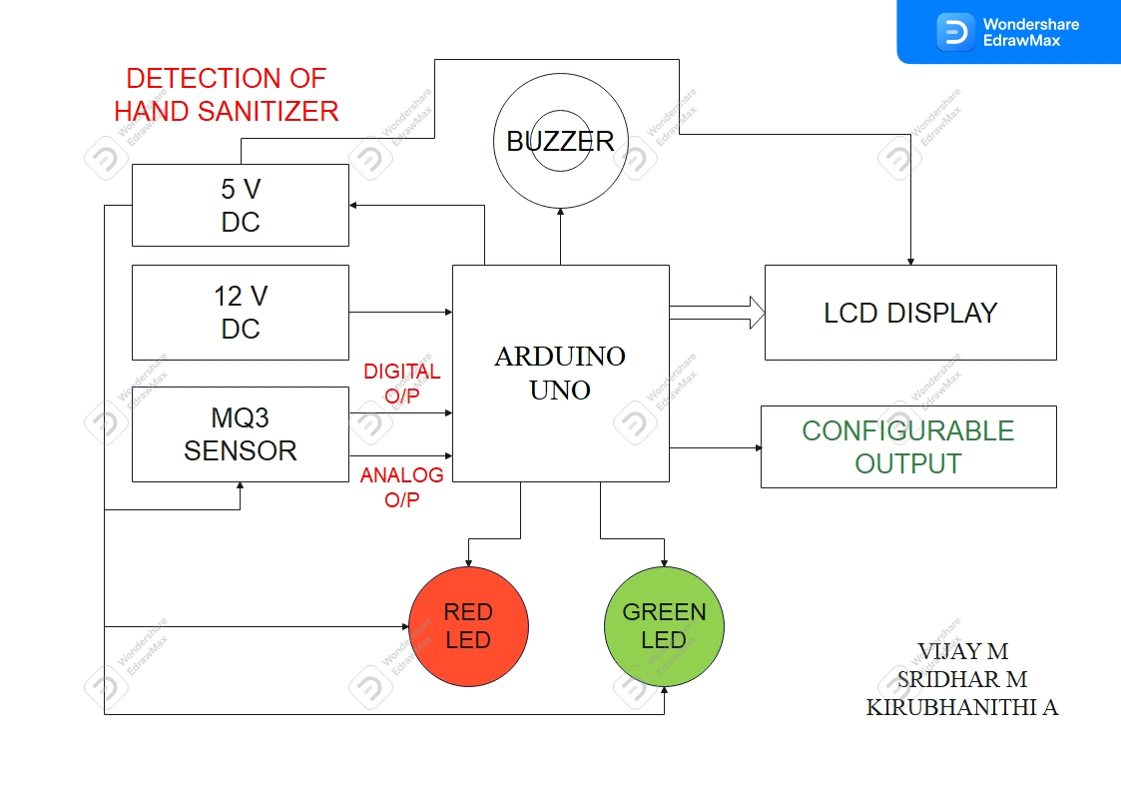
DETECTION OF HAND SANITIZER

Slide 10
CONCLUSION
Using this device can reduce the transmission of viruses through hands.
The MQ3 is a very low cost sensor, So the small shops also can afford this product easily.
Definitely, this product can contribute to reducing the transmission of viruses in pandemic situations.

Slide 11



THANK YOU!

